Slide 1
Machine Learning
Lecture 8: Supervised Classification Basic
Dr. Beilun Wang
Southeast University
School of Computer Science
and Engineering

Slide 2


Roadmap

Slide 3
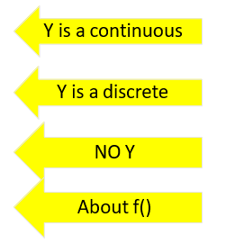
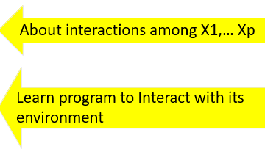
Course Content Plan
Six major sections of this course
❑ Regression (supervised)
❑ Classification (supervised)
❑ Unsupervised models
❑ Learning theory
❑ Graphical models
Reinforcement Learning

Slide 4
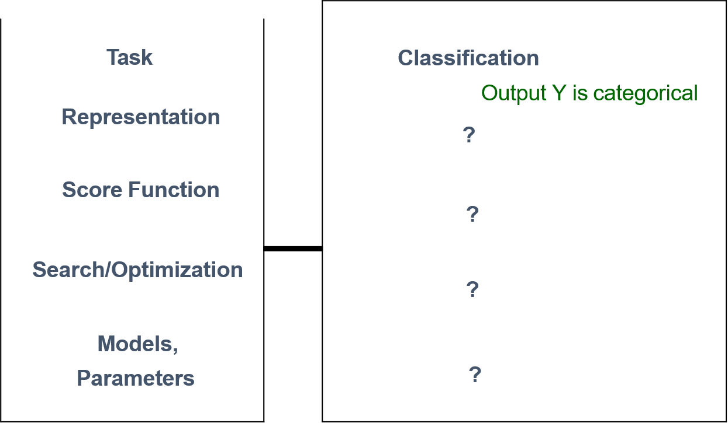
Today: Supervised Classification Introduction
Task: y
Representation:
x, f()
Score Function: L()
Search/Optimization
: argmin()
Models, Parameters :

Slide 5
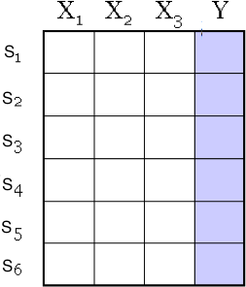
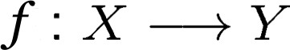
A Dataset
for regression
continuous valued variable
Data/points/instances/examples/samples/records: [ rows ]
Features/attributes/dimensions/independent variables/covariates/predictors/regressors: [ columns, except the last]
Target/outcome/response/label/dependent variable: special column to be predicted [ last column ]

Slide 6
Many Variants w.r.t. Y
Binary Classification
Multi-class Classification
Hierarchical Classification
Multi-label Classification
Structured Predictions
……

Slide 7
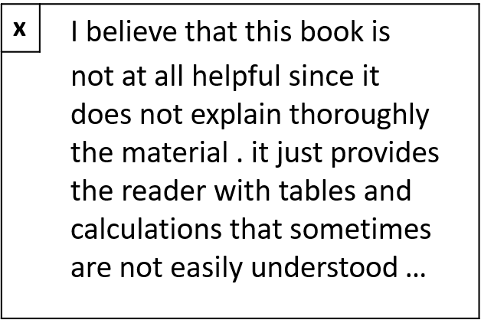
e.g.(1) Text Review-based Sentiment Classification
y
-1
Output Y: {1 / Yes , -1 / No }
e.g. Is this a positive product review ?
Input X : e.g. a piece of English text

Slide 8

e.g.(2) Linear Binary Classifier (2D)
y
x
f
X_2
f(x,w,b) = sign(w^{T} x + b)
X =(x_1, x_2)
w^{T}x + b>0
“Predict Class = +1”
x + b=0
zone
T
w
denotes +1 point
denotes -1 point
“Predict Class = -1”
zone
w^{T} x + b<0
x_1

Slide 9
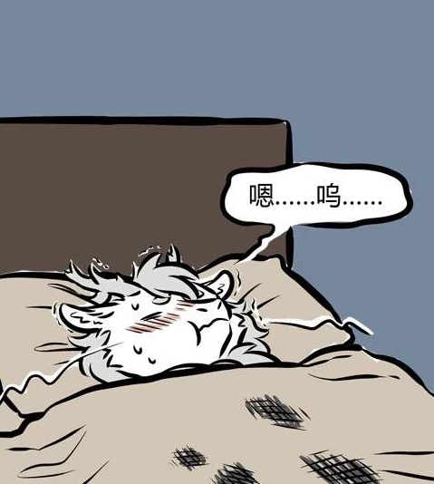

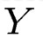

e.g.(3) Cancer Classification using gene expression
ill
Woo…
p genes’ quantities in blood cell
n
patient
blood samples
X
healthy

Slide 10
Many Variants w.r.t. Y
Binary Classification
Multi-class Classification
Hierarchical Classification
Multi-label Classification
Structured Predictions
……

Slide 11
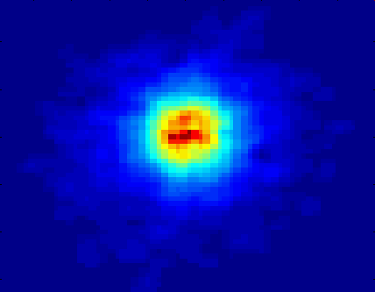
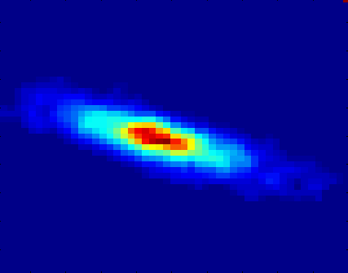
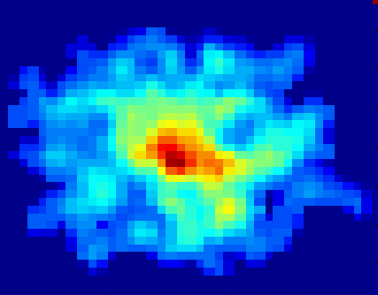
e.g.(1) Classifying Galaxies
Class:
Stages of formation
Attributes:
Image features,
Characteristics of light waves received, etc.
Early
Intermediate
Late
Data Size:
72 million stars, 20 million galaxies
Object catalog: 9 GB
Image database: 150 GB
From [Berry & Linoff] Data Mining Techniques, 1997
Courtesy:http://aps.umn.edu

Slide 12
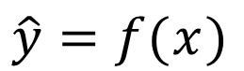

e.g.(2) Text Categorization
Pre-given categories and labeled document examples (Categories may form hierarchy)
Classify new documents
A standard supervised learning problem
Categorization System
Sports
Business
Education
…
Science
Sports Business
Education
…
$$y$$
$$\hat{y}=f(x)$$

Slide 13

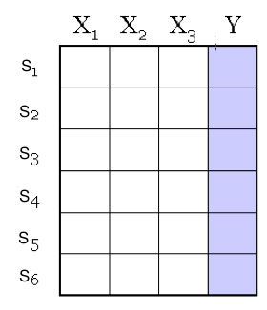
Bag of Words Representation
Text / String / Symbolic sequences
Variable length
Discrete
Combinatorial
Spatial ordering among units
How？
Dr. Yanjun
Qi / UVA CS

Slide 14
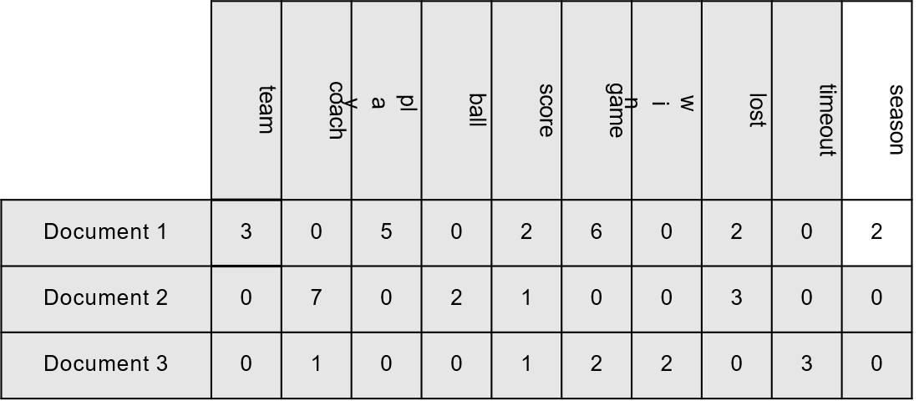
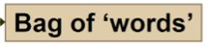
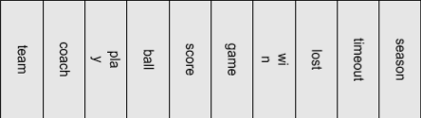
Text Document Representation
Each document becomes a ‘term’ vector
each term is an (attribute) of the vector
the value of each describes the number of times the corresponding term occurs in the document

Slide 15
Recall: Vector Space Representation
Each document is a vector, one component for each term (= word)
Normalize to unit length
High-dimensional vector space:
Terms are axes, 10,000+ dimensions, or even 100,000+
Docs are vectors in this space
 | Doc 1 | Doc 2 | Doc 3 | ...
Word 1 | 3 | 0 | 0 | ...
Word 2 | 0 | 8 | 1 | ...
Word 3 | 12 | 1 | 10 | ...
... | 0 | 1 | 3 | ...
... | 0 | 0 | 0 | ...

Slide 16



Multiple Classes in a Vector Space
Sports
Science
Arts

Slide 17
Test Document = ?
Sports
Science
Arts

Slide 18
Many Variants w.r.t. Y
Binary Classification
Multi-class Classification
Hierarchical Classification
Multi-label Classification
Structured Predictions
……

Slide 19

e.g.(1) Text Categorization
Google News

Slide 20
Applications of Text Categorization
News article classification
Meta-data annotation
Automatic Email sorting
Web page classification
……
Notes:
这一页不转换是这个意思吗

Slide 21
Many Variants w.r.t. Y
Binary Classification
Multi-class Classification
Hierarchical Classification
Multi-label Classification
Structured Predictions
……

Slide 22
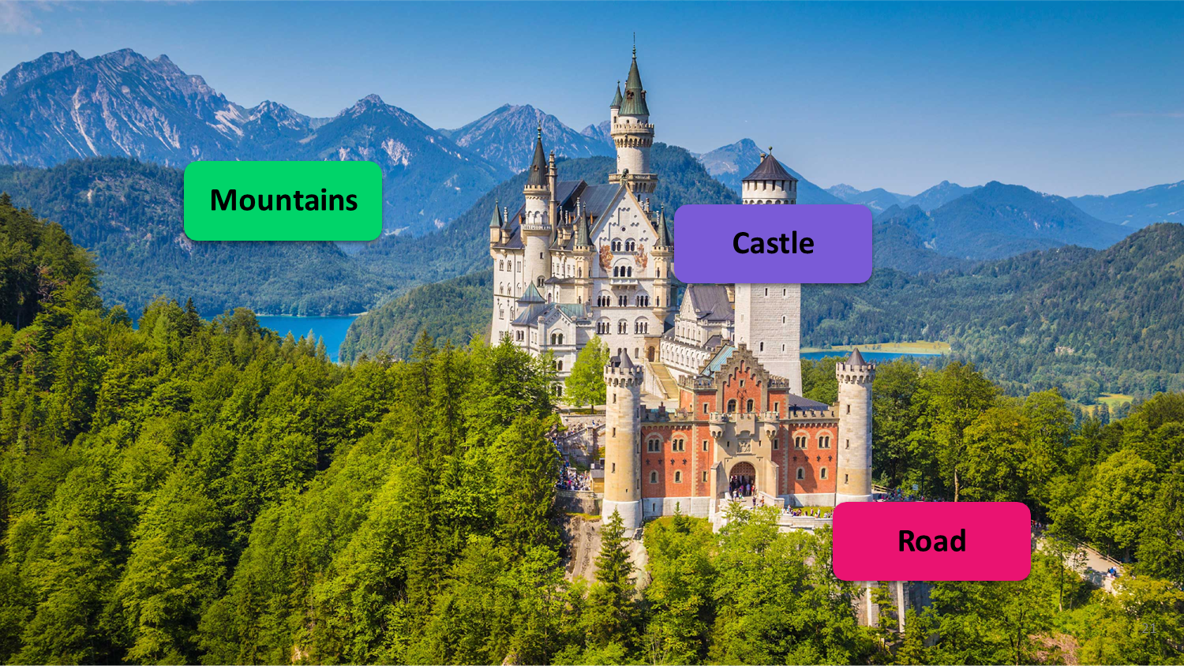
e.g.(1) Identify Items

Slide 23

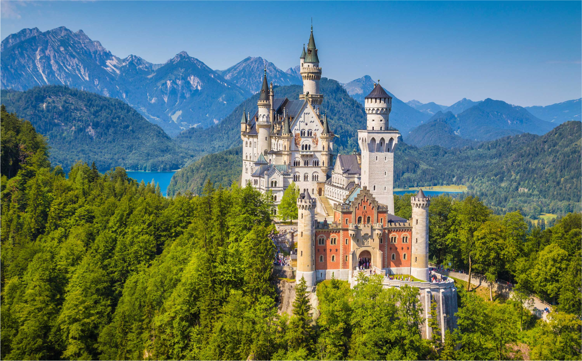

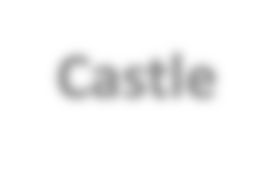













e.g.(1) Identify Items
MLC / Multi-label Classification is the task of assigning a set of target labels for a given sample
Given input x, predict the set of labels { y₁,y₂,...,y_{L}}, y_{i}∈{0,1}
y₁
y₂ y₃ y₄ y₅
Castle
City
x
Mountains
Car
Road

Slide 24
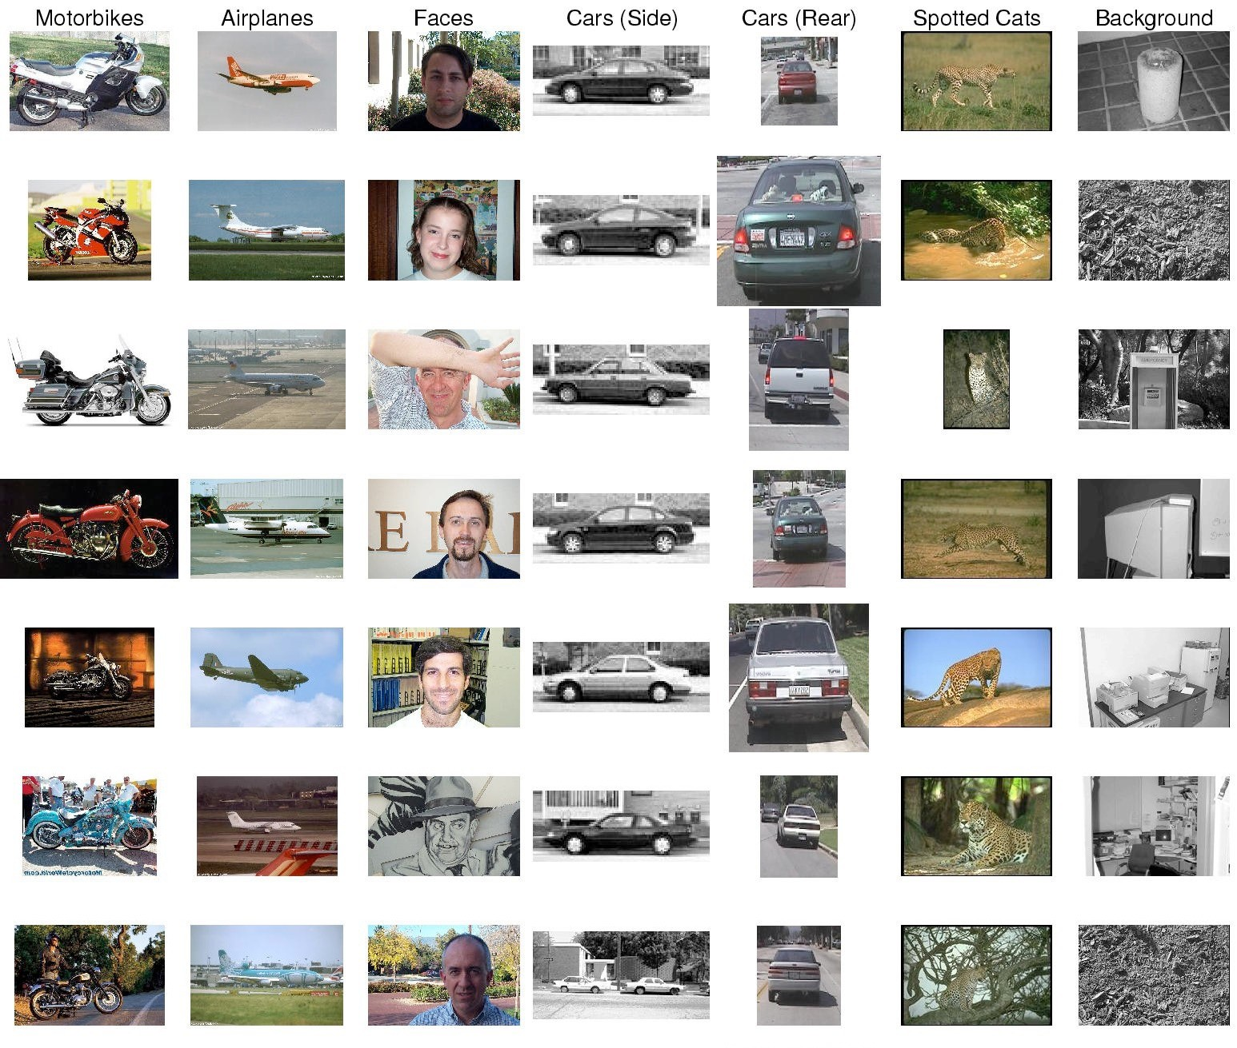
Application of MLC
e.g. Label Images into predefined word labels

Slide 25
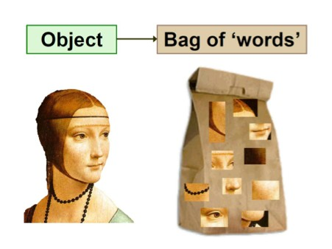
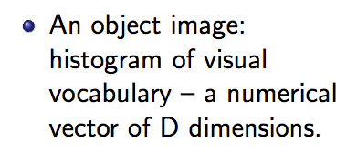
When not using Deep Learning: Image Representation for – Objective recognition
Image representation ➔ bag of “visual words”
visual

Slide 26
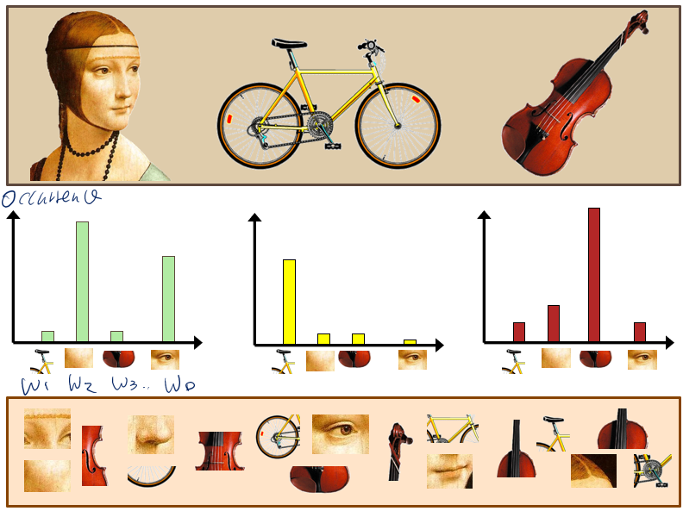

Slide 27
Many Variants w.r.t. Y
Binary Classification
Multi-class Classification
Hierarchical Classification
Multi-label Classification
Structured Predictions
……

Slide 28
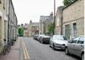
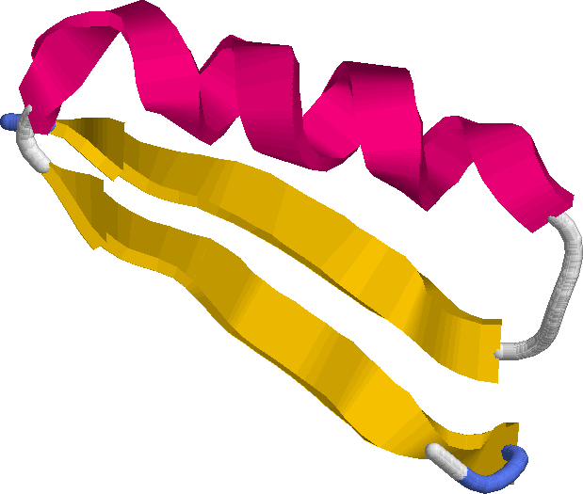
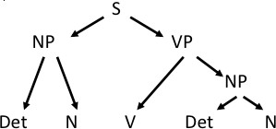
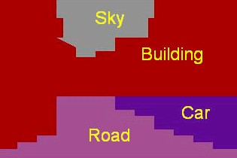
Some Examples
Many prediction tasks involve output labels having structured correlations or constraints among instances
Structured Dependency between Examples’ Y
Sequence
Tree
Grid
Input
APAFSVSPASGACGPECA…
The dog chased the cat
Output
CCEEEEECCCCCHHHCCC…
Many more possible structures between y_i , e.g. spatial , temporal, relational …

Slide 29
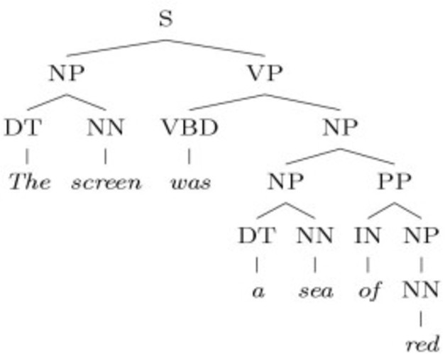
Structured Output: Natural Language Parsing
‘The screen was a sea of red’
Language Parsing

Slide 30
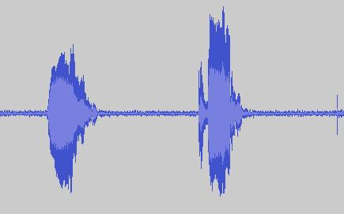
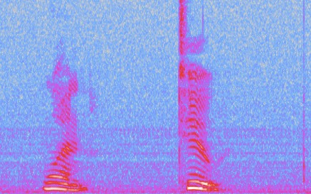
Structured Output: Audio Segmentation / Tagging
Real-life applications:
Customer service phone routing
Voice recognition software

Slide 31
Music Information Retrieval Systems
e.g. Automatic Music Recommendation
To classify music pieces in various ways
Genre or style classification
Mood classification
Performer or composer identification
Music recommendation •Playlist generation
Hit prediction
Audio to symbolic transcription
etc.
Such areas often share similar central procedures

Slide 32
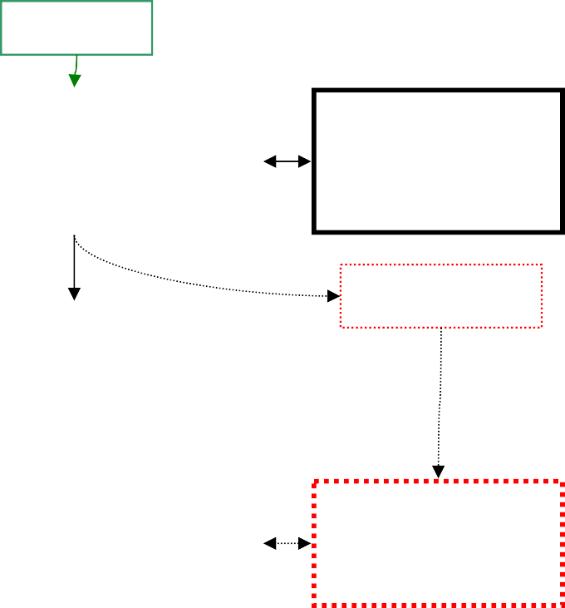
Music Information Retrieval Systems
e.g. Automatic Music Recommendation (Extra)
Musical data collection
The instances(basic entities) to classify
Audio recordings, scores, cultural data, etc.
Feature extraction
Features represent characteristic information about instances
Must provide sufficient information to segment instances among classes (categories)
Machine learning
Algorithms (“classifiers” or “learners”) learn to associate feature patterns of instances with their classes
Basic Classification Tasks
Music
Musical Data Collection
Metadata Analysis
Metadata
Feature Extraction
Machine Learning
Classifier Training
Classifications

Slide 33
Supervised Classifiers
 |  | Classification Output Y is cat Separation Boundary / Tree Local Smooth / Generative ? ? ?
Task Representation Score Function Search/Optimization Models, Parameters
Task: y
egorical
Representation:
x, f()
Score Function: L()
Search/Optimization
: argmin()
Models, Parameters :

Slide 34
Three major sections for classification
We can divide the large variety of classification approaches into roughly three major types：
Discriminative
directly estimate a decision rule/boundary
e.g., support vector machine, decision tree, logistic regression
e.g. neural networks (NN), deep NN
Generative
build a generative statistical model
e.g., Bayesian networks, Naïve Bayes classifier
Instance based classifiers
Use observation directly (no models)
e.g. K nearest neighbors

Slide 35
Review: How can we build more intelligent computer / machine ?
Able to
perceive the world
understand the world
react to the world
This needs
Basic speech capabilities
Basic vision capabilities
Language/semantic understanding
User behavior / emotion understanding
Able to act
Able to think ?

Slide 36
Supervised Classifiers
 |  | Classification Separation Boundary / Tree Local Smooth / Generative ? ? ACC / F1 / Many metric
Task Representation Score Function Search/Optimization Models, Parameters
Task: y
Output Y is categorical
Representation:
x, f()
Score Function: L()
Search/Optimization
: argmin()
Models, Parameters :

Slide 37
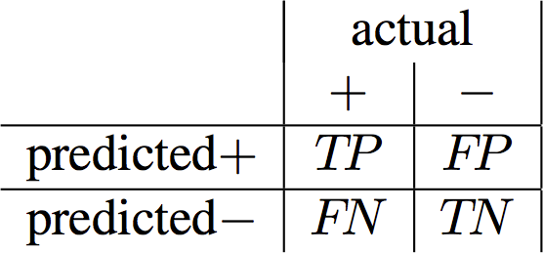
Accuracy Metrics
(number of) true positive (TP)
(number of) true negative (TN)
(number of) false positive (FP)
(number of) false negative (FN)

Slide 38
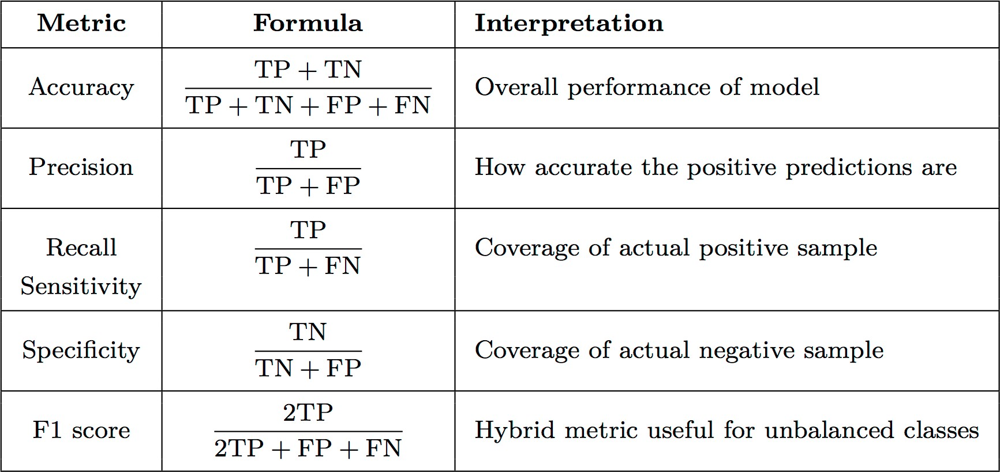
Accuracy Metrics

Slide 39
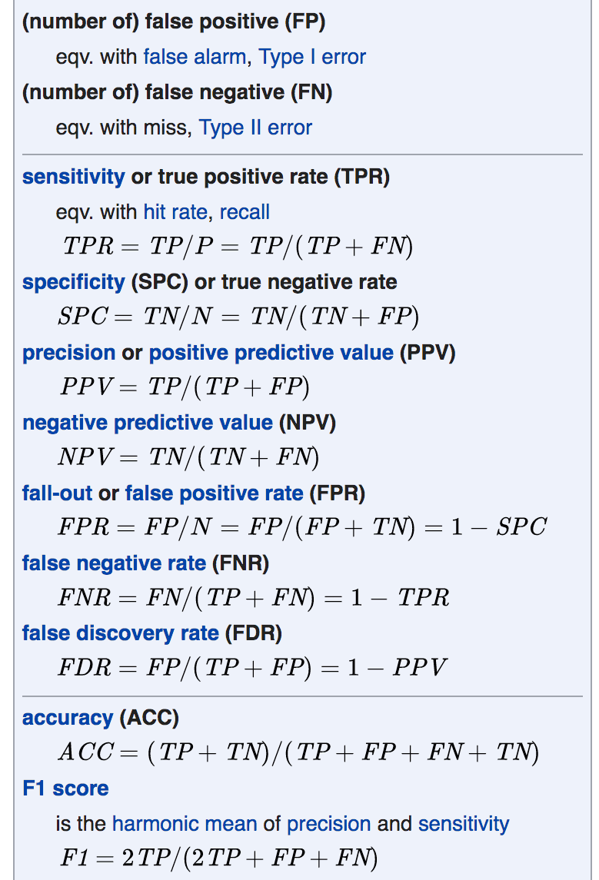
Accuracy Metrics
9/26/19 Dr. Yanjun Qi
/ UVA CS
From Wiki
43

Slide 40
Some Examples

Slide 41
Today Recap: Supervised Classifiers
 |  | Classification Separation Boundary / Tree Local Smooth / Generative ? ? ACC / F1 / Many metric
Task Representation Score Function Search/Optimization Models, Parameters
Task: y
Output Y is categorical
Representation:
x, f()
Score Function: L()
Search/Optimization
: argmin()
Models, Parameters :

Slide 42
References
https://qiyanjun.github.io/2019f-UVA-CS6316-MachineLearning/
https://www.wikipedia.org/

Slide 43
Thanks for listening

